Slide 1
Association Analysis
Prof.Vijayalakshmi Anand
BITS -Pilani

Slide 2
Association Analysis
Association analysis concepts
Apriori Algorithm for frequent itemsets
Closed pattern and Max pattern
FB growth algorithm
Rule generation
Evaluation measure

Slide 3
What is Association Analysis?
Association analysis measures the strength of co-occurrence between one item and another.
Association algorithms are widely used in
1.Retail analysis of transactions
Market basket analysis
change the store layout according to trends
customer behavior analysis
2.Online clickstream analysis across web pages.
3. Medical diagnosis

Slide 4
Association Rule Mining
Given a set of transactions, find rules that will predict the occurrence of an item based on the occurrences of other items in the transaction
Market-Basket transactions
Example of Association Rules
TID | Items
1 | Bread, Milk
2 | Bread, Diaper, Butter, Beans
3 | Milk, Diaper, Butter, Coke
4 | Bread, Milk, Diaper, Butter
5 | Bread, Milk, Diaper, Coke
{Diaper} → {Butter}, {Milk, Bread} → {Beans, Coke}, {Butter, Bread} → {Milk},

Slide 5
Terminologies used in association rule mining
Itemset
A collection of one or more items
Example: {Milk, Bread, Diaper}
k-itemset
An itemset that contains k items
Support count (σ)
Frequency of occurrence of an itemset
E.g. σ({Milk, Bread, Diaper}) = 2
Support
Fraction of transactions that contain an itemset
E.g. s({Milk, Bread, Diaper}) = 2/5
Frequent Itemset
An itemset whose support is greater than or equal to a minsup
TID | Items
1 | Bread, Milk
2 | Bread, Diaper, Butter, Beans
3 | Milk, Diaper, Butter, Coke
4 | Bread, Milk, Diaper, Butter
5 | Bread, Milk, Diaper, Coke

Slide 6
Definition: Association Rule
Association Rule
An implication expression of the form X → Y, where X and Y are itemsets
Example: {Milk, Diaper} → {Butter}
Rule Evaluation Metrics
Support (s)
Fraction of transactions that contain both X and Y
Confidence (c)
Measures how often items in Y appear in transactions that contain X
TID | Items
1 | Bread, Milk
2 | Bread, Diaper, Butter, Beans
3 | Milk, Diaper, Butter, Coke
4 | Bread, Milk, Diaper, Butter
5 | Bread, Milk, Diaper, Coke
Example:

Slide 7
Association Rule Mining Task
Given a set of transactions T, the goal of association rule mining is to find all rules having
support ≥ minsup threshold
confidence ≥ minconf threshold
Brute-force approach:
List all possible association rules
Compute the support and confidence for each rule
Prune rules that fail the minsup and minconf thresholds
⇒

Slide 8
Mining Association Rules
Example of Rules:
{Milk,Diaper} → {Butter} (s=0.4, c=0.67) {Milk,Butter} → {Diaper} (s=0.4, c=1.0)
{Diaper,Butter} → {Milk} (s=0.4, c=0.67)
{Butter} → {Milk,Diaper} (s=0.4, c=0.67) {Diaper} → {Milk,Butter} (s=0.4, c=0.5)
{Milk} → {Diaper,Butter} (s=0.4, c=0.5)
TID | Items
1 | Bread, Milk
2 | Bread, Diaper, Butter, Beans
3 | Milk, Diaper, Butter, Coke
4 | Bread, Milk, Diaper, Butter
5 | Bread, Milk, Diaper, Coke
Observations:
All the above rules are binary partitions of the same itemset: {Milk, Diaper, Butter}
Rules originating from the same itemset have identical support but can have different confidence
Thus, we may decouple the support and confidence requirements

Slide 9
Mining Association Rules
Two-step approach:
Frequent Itemset Generation
Generate all itemsets whose support ≥ μινσυπ
Rule Generation
Generate high confidence rules from each frequent itemset, where each rule is a binary partitioning of a frequent itemset
Frequent itemset generation is still computationally expensive

Slide 10
Frequent Itemset Generation
Given d items, there are 2^{d} possible candidate itemsets

Slide 11
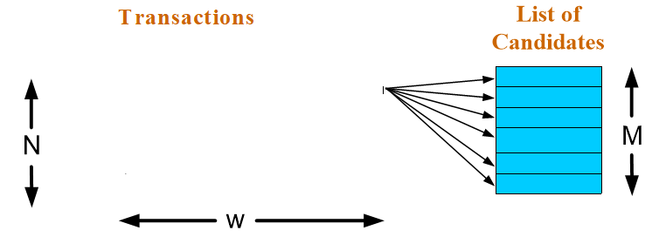
Frequent Itemset Generation
Brute-force approach:
Each itemset in the lattice is a candidate frequent itemset
Count the support of each candidate by scanning the database
Match each transaction against every candidate
Complexity ~ O(NMw) => Expensive since M = 2^{d} !!!
TID | Items
1 | Bread, Milk
2 | Bread, Diaper, Butter, Beans
3 | Milk, Diaper, Butter, Coke
4 | Bread, Milk, Diaper, Butter
5 | Bread, Milk, Diaper, Coke

Slide 12
Frequent Itemset Generation Strategies
Reduce the number of candidates (M)
Reduce the number of transactions (N)
Reduce the number of comparisons (NM)

Slide 13
Apriori Algorithm

Slide 14
Mining Association Rules
Two-step approach:
Frequent Itemset Generation
Generate all itemsets whose support ≥ μινσυπ
Rule Generation
Generate high confidence rules from each frequent itemset, where each rule is a binary partitioning of a frequent itemset
Frequent itemset generation is computationally expensive
Apriori principle can be used to reduce computations

Slide 15
Reducing Number of Candidates
Apriori principle:
If an itemset is frequent, then all of its subsets must also be frequent
Apriori principle holds due to the following property of the support measure:
Support of an itemset never exceeds the support of its subsets
This is known as the anti-monotone property of support

Slide 16
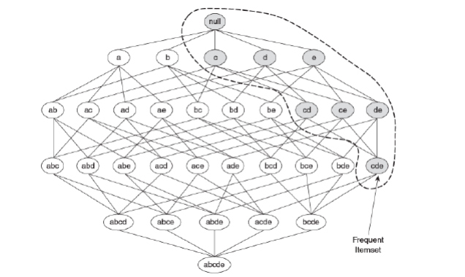
Illustrating Apriori Principle

Slide 17
Illustrating Apriori Principle
Found to be Infrequent
Pruned supersets

Slide 18
Apriori Algorithm
Method:
Let k=1
Generate frequent itemsets of length 1
Repeat until no new frequent itemsets are identified
Generate length (k+1) candidate itemsets from length k frequent itemsets
Prune candidate itemsets containing subsets of length k that are infrequent
Count the support of each candidate by scanning the DB
Eliminate candidates that are infrequent, leaving only those that are frequent

Slide 19
Important Details of Apriori
How to generate candidates?
Step 1: self-joining L_{k}
Step 2: pruning
Example of Candidate-generation
L₃={abc, abd, acd, ace, bcd}
Self-joining: L₃*L₃
abcd from abc and abd
acde from acd and ace
Pruning:
acde is removed because ade is not in L₃
C₄={abcd}
How to count supports of candidates?

Slide 20
Illustrating Apriori Principle
If every subset is considered,
⁶C₁ + ⁶C₂ + ⁶C₃ = 41
With support-based pruning,
6 + 6 + 1 = 13
Item | Count
Bread | 4
Coke | 2
Milk | 4
Butter | 3
Diaper | 4
Beans | 1
Items (1-itemsets)
Itemset | Count
{Bread,Milk} | 3
{Bread,Butter} | 2
{Bread,Diaper} | 3
{Milk,Butter} | 2
{Milk,Diaper} | 3
{Butter,Diaper} | 3
Pairs (2-itemsets)
(No need to generate candidates involving Coke or Beans)
Minimum Support = 3
TID | Items
1 | Bread, Milk
2 | Bread, Diaper, Butter, Beans
3 | Milk, Diaper, Butter, Coke
4 | Bread, Milk, Diaper, Butter
5 | Bread, Milk, Diaper, Coke
Triplets (3-itemsets)
Itemset | Count
{Bread,Milk,Diaper} | 2

Slide 21
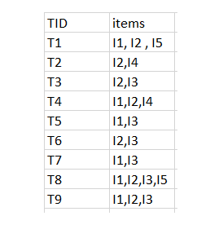
Example
minimum support count is 2 minimum confidence is 60%

Slide 22
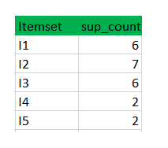
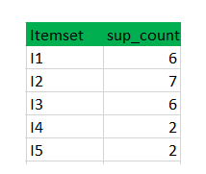
Step-1: K=1 (I) Create a table containing support count of each item present in dataset – Called C1(candidate set)
(II) compare candidate set item’s support count with minimum support count(here min_support=2 if support_count of candidate set items is less than min_support then remove those items). This gives us itemset L1.

Slide 23
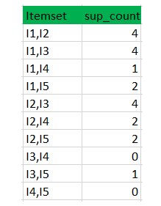
Step2
Step-2: K=2
Generate candidate set C2 using L1 (this is called join step). Condition of joining L_{k-1} and L_{k-1} is that it should have (K-2) elements in common.
Check all subsets of an itemset are frequent or not and if not frequent remove that itemset.(Example subset of{I1, I2} are {I1}, {I2} they are frequent.Check for each itemset)
Now find support count of these itemsets by searching in dataset.

Slide 24
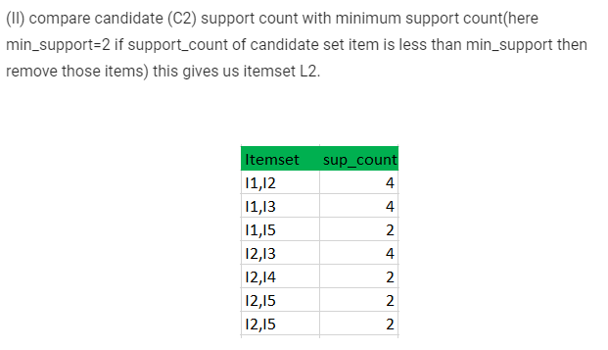

Slide 25
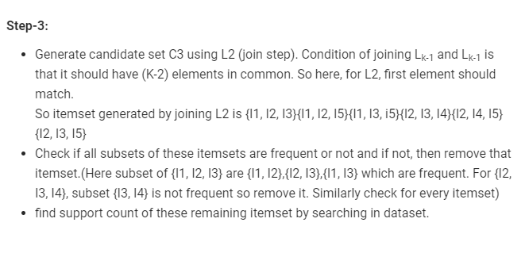
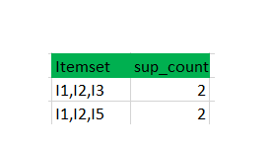

Slide 26
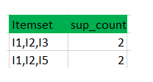
II) Compare candidate (C3) support count with minimum support count(here min_support=2 if support_count of candidate set item is less than min_support then remove those items) this gives us itemset L3.
step4
Generate candidate set C4 using L3 (join step). Condition of joining L_{k-1} and L_{k-1} (K=4) is that, they should have (K-2) elements in common. So here, for L3, first 2 elements (items) should match.
Check all subsets of these itemsets are frequent or not (Here itemset formed by joining L3 is {I1, I2, I3, I5} so its subset contains {I1, I3, I5}, which is not frequent). So no itemset in C4

Slide 27
[I1,I2]=>[I3]
confidence = sup(I1,I2,I3)/sup(I1,I2) = 2/4*100=50% [I1,I3]=>[I2]
confidence = sup(I1,I2,I3)/sup(I1,I3) = 2/4*100=50% [I2,I3]=>[I1]
confidence = sup(I1,I2,I3)/sup(I2,I3) = 2/4*100=50% [I1]=>[I2,I3]
confidence = sup(I1,I2,I3)/sup(I1) = 2/6*100=33% [I2]=>[I1,I3]
confidence = sup(I1,I2,I3)/sup(I2) = 2/7*100=28% [I3]=>[I1,I2]
confidence = sup(I1,I2,I3)/sup(I3) = 2/6*100=33%

Slide 28
Factors Affecting Complexity
Choice of minimum support threshold
Dimensionality (number of items) of the data set
Number of Transactions
Average transaction width

Slide 29
Can we improve Apriori Efficiency?
Hash-based technique
Transaction reduction
Partitioning
Sampling

Slide 30
Hash Based Techniques
Step1: In the first iteration, find out the support count of each items .
Step2:In second iteration i.e 2 item set generation ,for every combinations of two item, map them into the diverse bucket of hash table structure and increment the bucket count
Step3:Remove the bucket which count is less than minimum support.

Slide 31
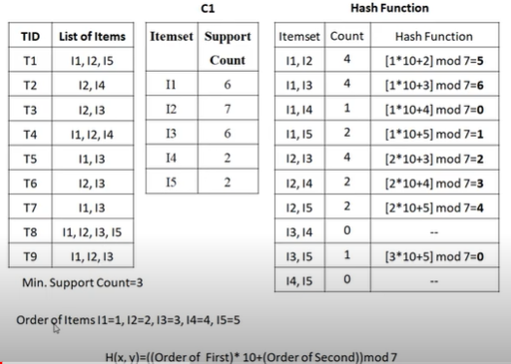
Hash Based technique -Example

Slide 32
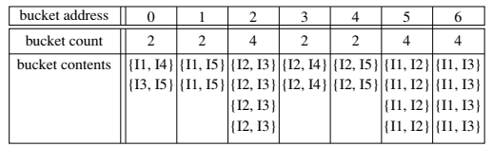

Slide 33

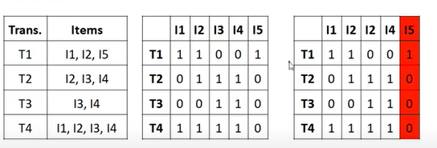
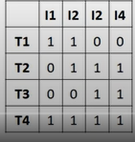
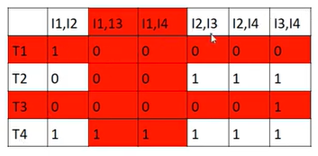
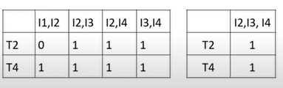
Efficiency Techniques
Transaction reduction
A transaction that does not contain any frequent k-itemsets cannot contain any frequent (k + 1)-itemsets. Such a transaction can be removed from further consideration .
Example

Slide 34
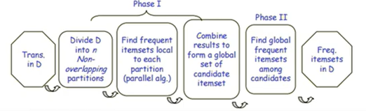
Partitioning
It has two phases. In phase I, divide the transactions of D into n partitions. Each partition has proportionally lower threshold. For each partition, all the local frequent itemsets are found.
Any itemset that is potentially frequent with respect to D must be a frequent itemset in at least one of the partitions. Therefore, all local frequent itemsets are candidate itemsets with respect to D

Slide 35
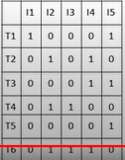
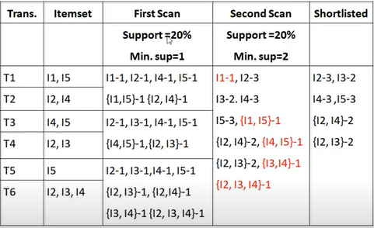
Example

Slide 36
Closed Patterns and Max-Patterns

Slide 37
Closed Patterns and Max-Patterns
The Maximal and Closed Frequent Item sets are two representations that are subsets of the larger frequent item set.
Max patterns
It is a frequent itemset for which none of its immediate supersets are frequent.
Closed patterns
It is a frequent itemset that is both closed and its support is greater than or equal to minsup. An itemset is closed in a data set if there exists no superset that has the same support count as this original itemset.

Slide 38
Example
The minimum support count is 2.
suppose there are a total of 3 items: a, b, c.
Suppose a pattern ab has support count of 2 and a pattern abc has support count of 2.
Is the pattern ab is a closed pattern?
2.
suppose there are a total of 3 items: x, y, z.
suppose a pattern xy has support count of 3 and a pattern xyz has support count of 2.
Is the pattern xy is a closed pattern?

Slide 39
Example-Max Pattern
The minimum support count is 2.
1,suppose there are a total of 3 items: a, b, c.
Suppose a pattern ab has support count of 3 and a pattern abc has support count of 2.
Is the pattern ab is a max pattern?
2.suppose there are a total of 3 items: x, y, z.
Suppose a pattern xy has support count of 3 and a pattern xyz has support count of 1.
Is the pattern xy is a max pattern?

Slide 40
Maximal vs Closed Itemsets
Transaction Ids
Not supported by any transactions

Slide 41
Maximal vs Closed Frequent Itemsets
Minimum support = 2
Closed but not maximal
Closed and maximal
# Closed = 9
# Maximal = 4

Slide 42
Maximal vs Closed Itemsets

Slide 43
FP-growth Algorithm

Slide 44
Bottleneck of Frequent-pattern Mining
Multiple database scans are costly
Mining long patterns needs many passes of scanning and generates lots of candidates
To find frequent itemset i₁i₂…i₁₀₀
# of scans: 100
# of Candidates: (₁₀₀¹) + (₁₀₀²) + … + (₁¹₀⁰₀⁰) = 2¹⁰⁰-1 = 1.27*10³⁰ !
Bottleneck: candidate-generation-and-test
Can we avoid candidate generation?

Slide 45
FP-growth Algorithm
Use a compressed representation of the database using an FP-tree
Once an FP-tree has been constructed, it uses a recursive divide-and-conquer approach to mine the frequent itemsets
Scan DB once, find frequent 1-itemset (single item pattern)
Sort frequent items in frequency descending order, f-list
Scan DB again, construct FP-tree

Slide 46
Example

Slide 47
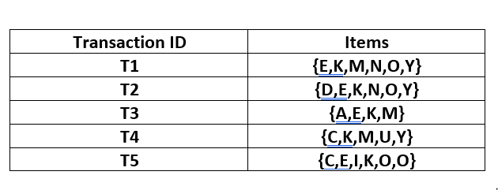
minimum support be 3

Slide 48
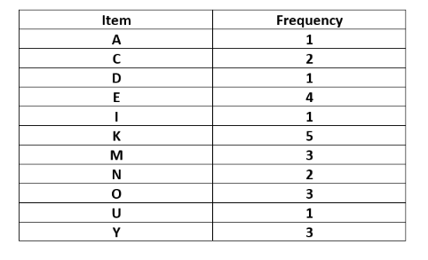
Frequency of all individual items
L = {K : 5, E : 4, M : 3, O : 3, Y : 3}

Slide 49
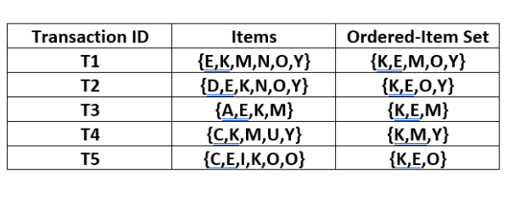

Slide 50
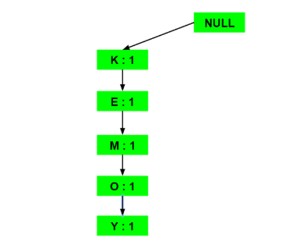
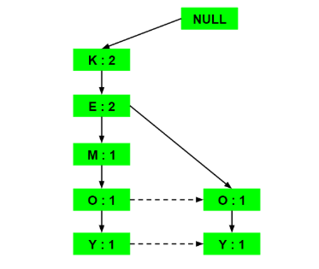
a) Inserting the set {K, E, M, O, Y}:
b) Inserting the set {K, E, O, Y}:

Slide 51
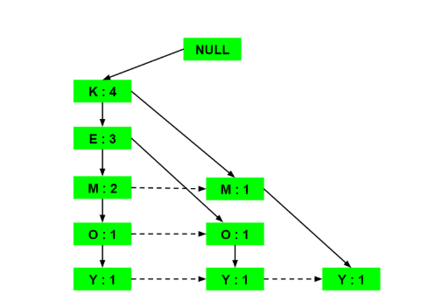
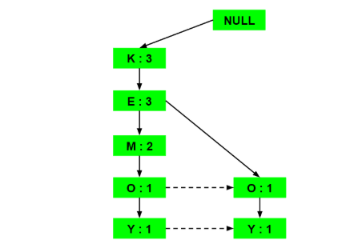
c) Inserting the set {K, E, M}:
d) Inserting the set {K, M, Y}:

Slide 52
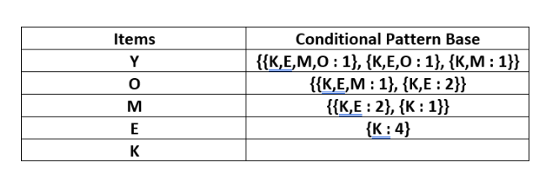
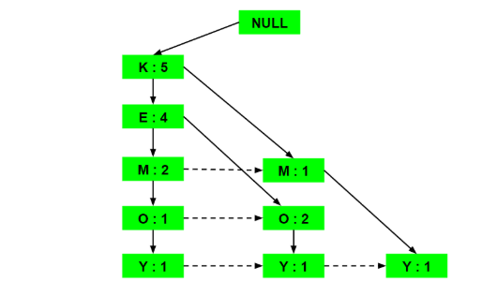
e) Inserting the set {K, E, O}:

Slide 53
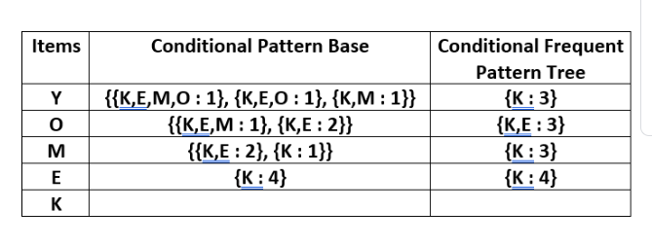
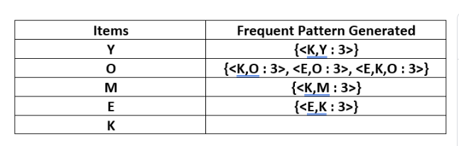

Slide 54
Benefits of the FP-tree Structure
Completeness
Compactness

Slide 55
Why Is FP-Growth the Winner?
Divide-and-conquer:
Other factors
no candidate generation, no candidate test
compressed database: FP-tree structure
no repeated scan of entire database
basic ops—counting local freq items and building sub FP-tree, no pattern search and matching

Slide 56
Association Rule Generation

Slide 57
Rule Generation
Given a frequent itemset L, find all non-empty subsets f ⊂ L such that f → L – f satisfies the minimum confidence requirement
If {A,B,C,D} is a frequent itemset, candidate rules:
ABC →Δ, ΑΒΔ →Χ, ΑΧΔ →Β, ΒΧΔ →Α, Α →ΒΧΔ, Β →ΑΧΔ, Χ →ΑΒΔ, Δ →ΑΒΧ ΑΒ →ΧΔ, ΑΧ → ΒΔ, ΑΔ → ΒΧ, ΒΧ →ΑΔ, ΒΔ →ΑΧ, ΧΔ →ΑΒ,
If |L| = k, then there are 2^{k} – 2 candidate association rules

Slide 58
Rule Generation
How to efficiently generate rules from frequent itemsets?
In general, confidence does not have an anti-monotone property
c(ABC →Δ) χαν βε λαργερ ορ σμαλλερ τηαν χ(ΑΒ →Δ)
But confidence of rules generated from the same itemset has an anti-monotone property
if a rule X→(Y-X) does not satisfy the confidence threshold, then any rule X’→(Y-X’), where X’ is a subset of X, must not satisfy the confidence threshold

Slide 59
Rule Generation for Apriori Algorithm
Lattice of rules
Low Confidence Rule
Pruned Rules

Slide 60
Effect of Support Distribution
How to set the appropriate minsup threshold?
If minsup is set too high, we could miss itemsets involving interesting rare items (e.g., expensive products)
If minsup is set too low, it is computationally expensive and the number of itemsets is very large
Using a single minimum support threshold may not be effective

Slide 61
Multiple Minimum Support
How to apply multiple minimum supports?
MS(i): minimum support for item i
e.g.: MS(Milk)=5%, MS(Coke) = 3%, MS(Broccoli)=0.1%, MS(Salmon)=0.5%
MS({Milk, Broccoli}) = min (MS(Milk), MS(Broccoli)) = 0.1%

Slide 62
Pattern Evaluation
Association rule algorithms tend to produce too many rules
many of them are uninteresting or redundant
Redundant if {A,B,C} → {D} and {A,B} → {D} have same support & confidence
Interestingness measures can be used to prune/rank the derived patterns

Slide 63
Subjective Interestingness Measure
Objective measure:
Rank patterns based on statistics computed from data
e.g., many measures of association (support, confidence, Laplace, Gini, mutual information, Jaccard, etc).
Subjective measure:
Rank patterns according to user’s interpretation

Slide 64
Computing Interestingness Measure
Given a rule X → Y, information needed to compute rule interestingness can be obtained from a contingency table
Contingency table for X → Y
 | Y | Y
X | f₁₁ | f₁₀ | f₁₊
X | f₀₁ | f₀₀ | f_{o+}
 | f₊₁ | f₊₀ | |T|
f₁₁: support of X and Y f₁₀: support of X and Y f₀₁: support of X and Y f₀₀: support of X and Y
Used to define various measures
support, confidence, lift, Gini, J-measure, etc.

Slide 65
Drawback of Confidence
 | Coffee | Coffee
Tea | 15 | 5 | 20
Tea | 75 | 5 | 80
 | 90 | 10 | 100
Association Rule: Tea → Coffee
Confidence= P(Coffee|Tea) = 0.75
but P(Coffee) = 0.9
Although confidence is high, rule is misleading

Slide 66



Statistical-based Measures
Measures that take into account statistical dependence

Slide 67
Example: Lift/Interest
 | Coffee | Coffee
Tea | 15 | 5 | 20
Tea | 75 | 5 | 80
 | 90 | 10 | 100
Association Rule: Tea → Coffee
Confidence= P(Coffee|Tea) = 0.75
but P(Coffee) = 0.9
Lift = 0.75/0.9= 0.8333 (< 1, therefore is negatively associated)

Slide 68
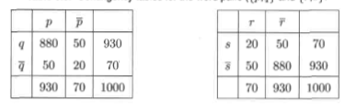
Drawback of lift /interest
Lift=1000*880/930*930
=1.017
Lift=4.08

Slide 69
Prescribed Text Books
 | Author(s), Title, Edition, Publishing House
T1 | Tan P. N., Steinbach M & Kumar V. “Introduction to Data Mining” Pearson Education
T2 | Data Mining: Concepts and Techniques, Third Edition by Jiawei Han, Micheline Kamber and Jian Pei Morgan Kaufmann Publishers
R1 | Predictive Analytics and Data Mining: Concepts and Practice with RapidMiner by Vijay Kotu and Bala Deshpande Morgan Kaufmann Publishers
R2 | Oracle Documentation (http://docs.oracle.com/cd/B28359_01/datamine.111/b28129/regress.htm)

Slide 70
Thank you ☺
Q&A
Suggestions / Feedback

